Slide 1
Chapter 2: the image, its representation and properties
Image processing, analysis and machine vision
Dong Sun Park
Sunday, March 29, 2020

Slide 2
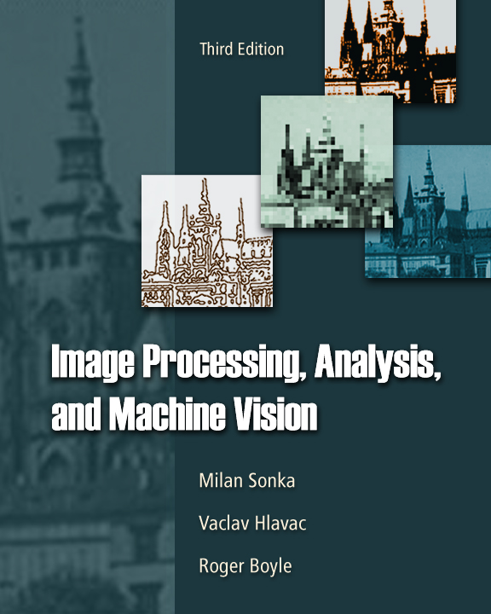
Outline
Image representation and a few concepts
Image digitization
Digital image properties
Color images
Cameras: an overview

Slide 3
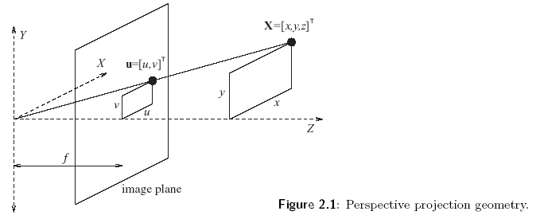

What is an image?
Real world is continuous:
Two v$ariables: f(x,y)$. $x,y are$ co-ordinates in a plane.
Three variables: $f\left(x,y,t\right),$ $t$is time.
2D image is the result of a perspective projection of the 3D scene
The continuous
Image function

Slide 4
Image function
U =xf /z, v= yf/z
Depth recovery from 2D static images
Image function for a region R
R = {(x,y), 1 < x<xm, 1<y<ym}
Illumination for monochromatic images
Gray levels from black to white
Resolutions
Spatial: proximity of samples
Spectral: bandwidth of light frequencies captured by the sensor
Radiometric: number of distinguishable gray levels
Time: interval between time samples

Slide 5
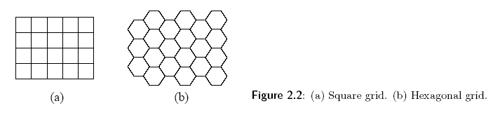

Image digitization
Image digitization means that the function $f(x,y)$ of two-coordinates into a matrix with $m$ rows and $n$ rows.
Quantization: assigns to each continuous sample an integer value. The transition between continuous values of the image function (brightness) and its digital equivalent is called quantization.

Slide 6
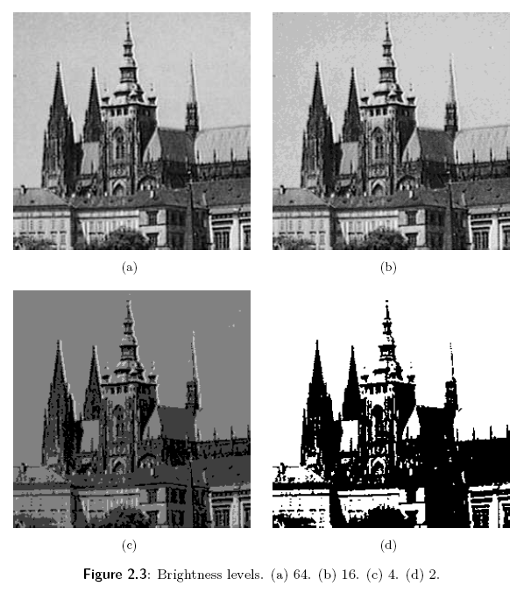

The number of quantization levels should be high enough to permit human perception of fine shading details in the image.
$k=2^{b}$, eight bit per pixel per channel are commonly used.
Levels:
(a) 256
(b) 64
(c) 16
(d) 2

Slide 7
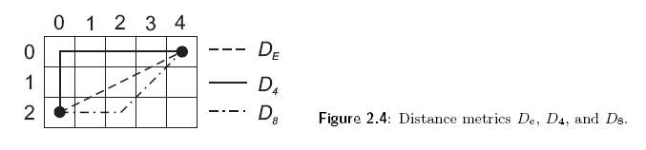
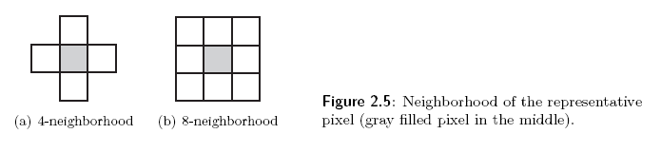

Digital image properties
Distance in image
$D_{2}$Euclidean
$D_{4}$City block
$D_{8}$Chessboard
Pixel adjacency: 4 or 8

Slide 8

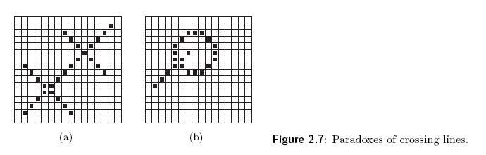
Contiguous: if there is a path between two pixels in the set of pixels in the image, these pixels are called contiguous.
Background, object.
Region and lines.

Slide 9
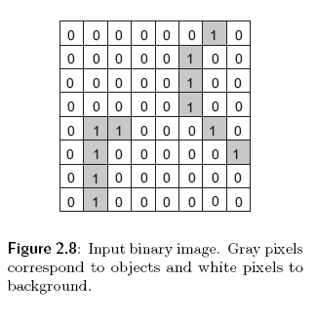
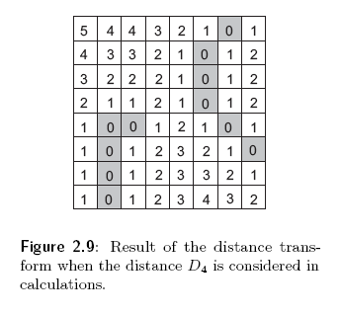
Distance transform: provides the distance of pixels from some image subset (perhaps describing objects or some features).

Slide 10
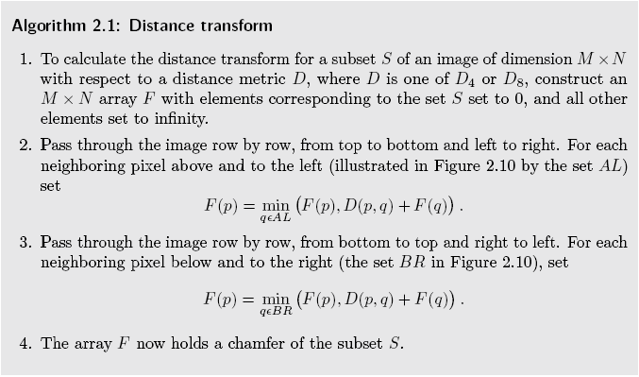

Slide 11
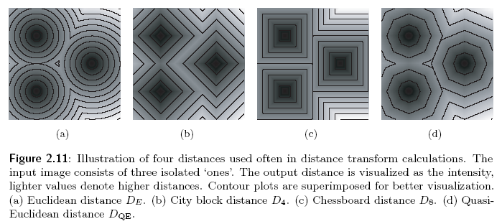
Four distances used often in distance transform calculations

Slide 12
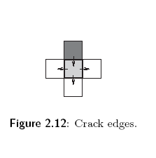
Edge is a further important concept used in image analysis. The edge tells us hot fast the image intensity varies in a small neighborhood of a pixel.
Crack edge creates a structure between pixels in similar manner to that of cellular complexes.

Slide 13
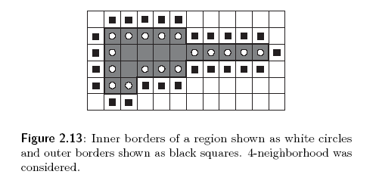
A border of a region is another important concept in image analysis.
The border of a region R is the set of pixels within the region that have one or more neighbor outside R.
Inner border or outer border.

Slide 14
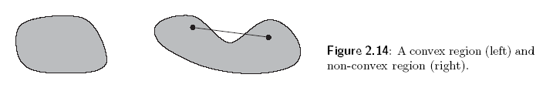

The shape of a region can be qualitatively described using the property of being convex.
A convex hull is a concept used to describe qualitative properties of objects. The convex hull is the smallest convex region containing the input region, possibly non-convex.

Slide 15

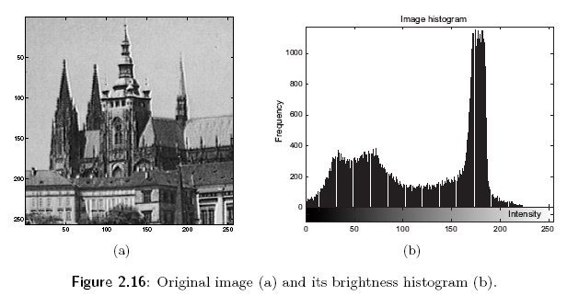
Histograms provides a natural bridge between images and a probabilistic description.
The brightness histogram of an image provides the frequency of the brightness value in the image.

Slide 16
Entropy: if a probability density is known then image information content can be estimated regardless of its interpretation using entropy.
An intuitive understanding of information entropy relates to the amount of uncertainty about an event associated with a given probability distribution.

Slide 17
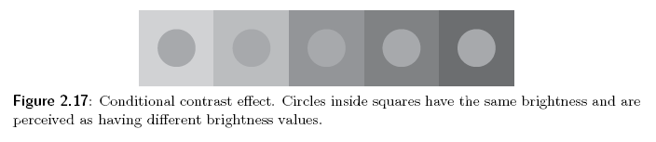
Visual perception of the image:
1 Contrast: the local image change in brightness and is defined as the ratio between average brightness of an object and the background.
2 Acuity: the ability to detect details in an image. The human eye is less sensitive to slow and fast changes in brightness in the image plane but is more sensitive to intermediate changes. Acuity also decreases with increasing distance from the optical axis.

Slide 18
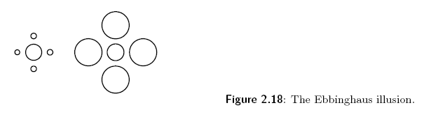
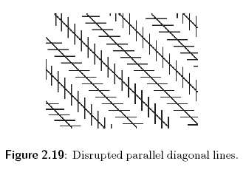
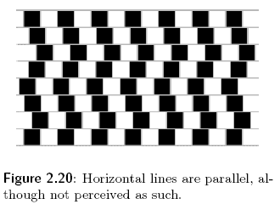
3 Some visual illusions

Slide 19
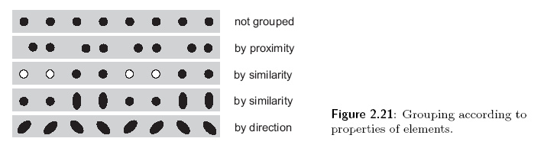
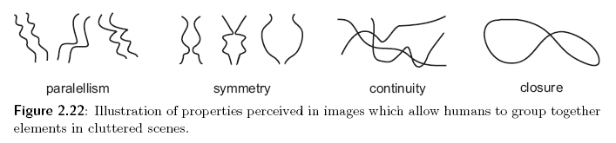
4 perceptual grouping is a principle used in computer vision to aggregate elements provided by low-level operations such as edges, which are small blobs to bigger chunks having some meaning.

Slide 20
Image quality: an image might be degraded during capture, transmission or processing, and measures of image quality can be used to assess the degree of degradation.
The quality required naturally depends on the purpose for which an image is used.
Methods can be grouped into two categories:
Subjective
Objective

Slide 21

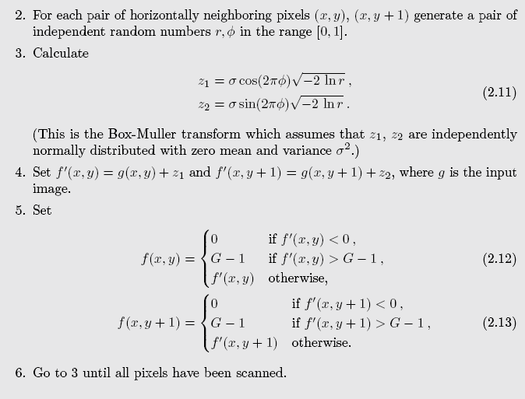
Noise in image: real image are often degraded by some random errors, this degradation is usually called noise.
White noise
One special of white noise is gaussian noise

Slide 22
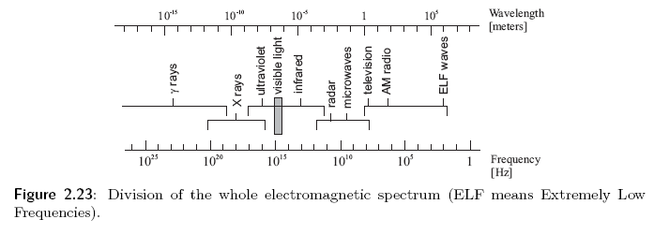
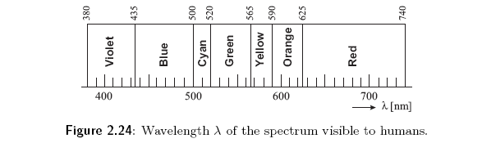
Color images
The electromagnetic spectrum, only a narrow section is visible to a human.
Only 380-740nm

Slide 23
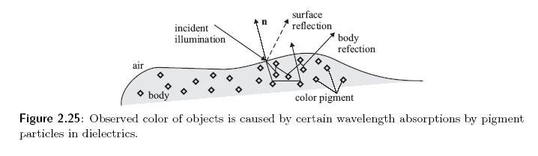
Why do we see the world in color?
Two mechanisms:
Surface reflection
Body reflection

Slide 24
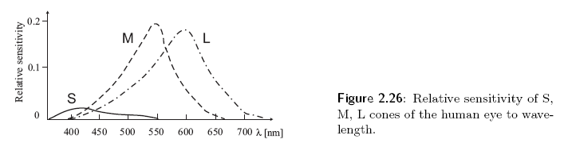
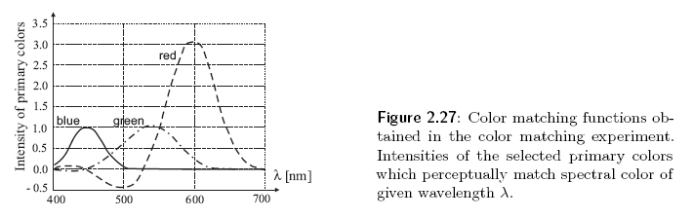
Color perceived by human
Color sensitive receptors on the human eye are the cones.
Cones S, M, L are occasionally called B, G, and R receptively.

Slide 25
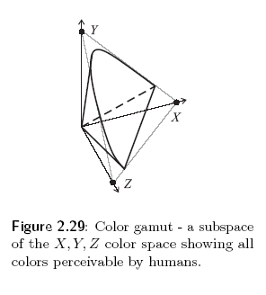

XYZ color model space shows all colors perceivable by humans. $X=700nm≈red,Y=546.1nm≈green,Z=435.8nm≈blue.$
$color= c_{x}X+c_{y}Y+c_{z}Z$

Slide 26
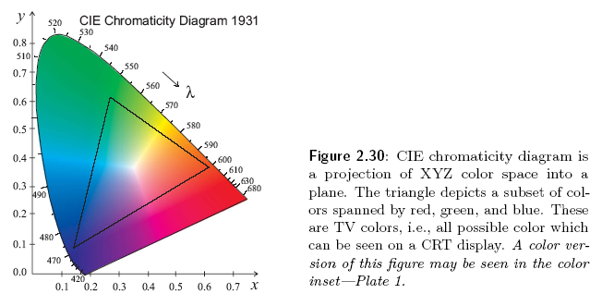

CIE chromaticity becomes three dimensions into two dimensions.
$x=\frac{X}{X+Y+Z}$
$y=\frac{Y}{X+Y+Z}$
$z=1−x−y$

Slide 27
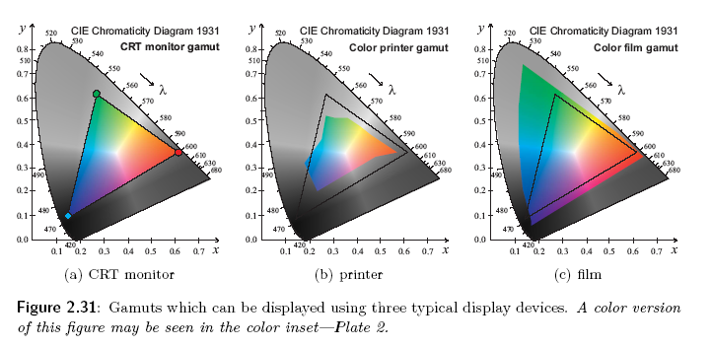
Different CIE for various field.

Slide 28
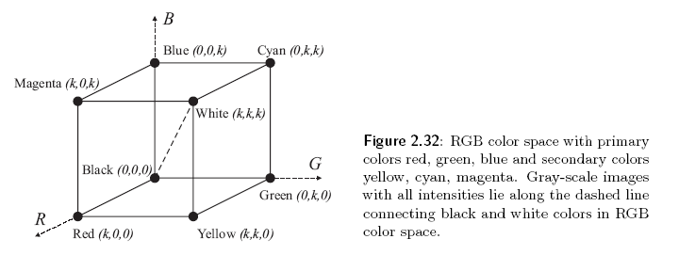
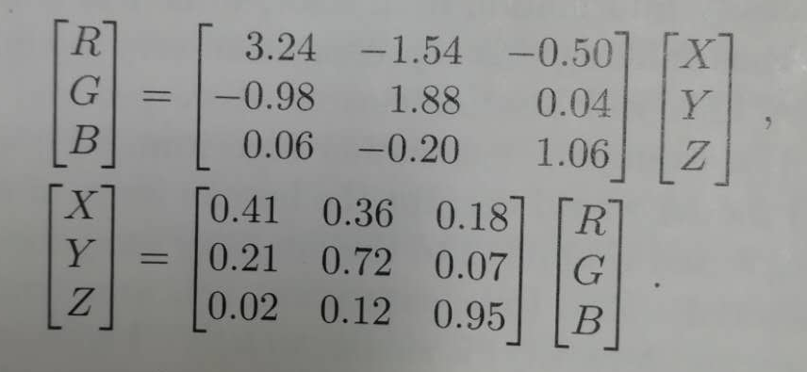
From XYZ to RGB color space.

Slide 29
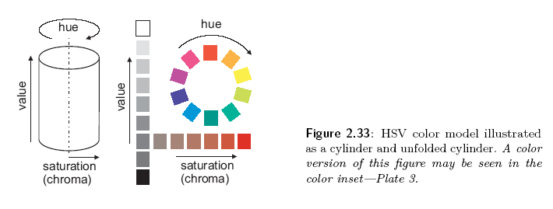
HSV color model: Hue, saturation and value. It is often used by painters because it is closer to their thinking and technique.
Decouple intensity information from color, while hue and saturation correspond to human perception.

Slide 30
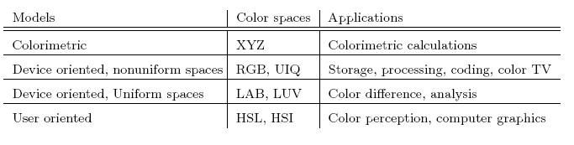
Several color spaces and models and its applications

Slide 31
Palette images provide a simple way to reduce the amount of data needed to represent an image. The pixel values constitute a link to a lookup table. The lookup table contains as many entries as the range of possible values in the pixel, which is typically 8 bits (256 values)

Slide 32
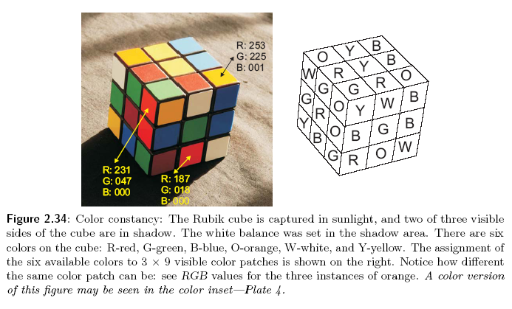
Color constancy. Human vision system is able to abstract to a certain degree from the illumination changes and perceive several instances of a particular color as same. This phenomenon is called color constancy.

Slide 33
Camera: an overview
Photosensitive sensors
Based on photo-emission principles: explore the photoelectric effect
Based on photovoltaic principle: is explored in several technological elements as a photodiode, and avalanche photodiode, a photoresistor, and Schottky photodiode.
Two types of semiconductor photoresistive sensors used widely in cameras”
CCDs, charge-coupled devices: every pixel’s charge is transferred through just one output node to be converted to voltage, buffered and sent off-chip as an analog signal. All of the pixel area can be devoted to light capture.
CMOS: complementary metal oxide semiconductor

Slide 34
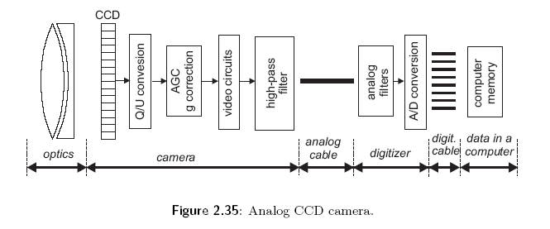
A monochromatic camera consists of the optical system (lens), the photosensitive sensor and electronics which enables the processing of a captured image, and transfer to futher processing.
Analog
Digital

Slide 35
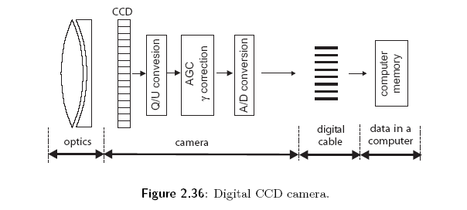
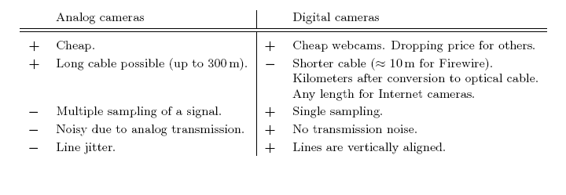
Analog
Digital
Analog vs. Digital

Slide 36
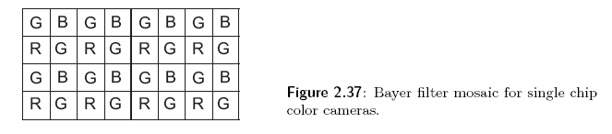
A color camera
Three strategies:
Record three different images in succession. This is used only in precise laboratory measurements.
Using a color filter array on a single sensor.
The incoming light is split into several color channels using a prism-like device.

